Slide 1
Plagiarism Checker for NCCS
By: Sabhyata Aryal
NCCSCSIT 519

Slide 2
Introduction
With repeated submission of similar projects across academic batches, the risk of plagiarism has significantly increased.
Manual plagiarism checking is time-consuming, unreliable, and impractical.
This project proposes an automated plagiarism checker for NCCS to support teachers in efficiently verifying the originality of student project reports.

Slide 3
Problem Statement
Currently, NCCS does not have an automated system to verify the originality of project reports.
Teachers rely on manual inspection, which is inefficient, time-consuming, and error-prone.
The absence of a centralized repository of previously submitted project reports increases the risk of students submitting copied content.

Slide 4
Objective
To develop an automated plagiarism detection system that checks textual similarity between newly submitted project reports and previously submitted NCCS project reports.

Slide 5
Algorithms
N-Gram Based Similarity Detection
What it is: measures how alike two text strings are by breaking them into overlapping sequences of 𝑛 consecutive characters or words (n-grams or shingles)
I am the king
1-gram(unigram): (I) (am) (the) (king)
2-gram(bigram): (I am) (am the) (the king)
3-gram(trigram): (I am the) (am the king)

Slide 6
Conceptual Background of n-gram
Unigram Probability: P(w) = count(w)/N
Bayes Rule: P(A|B) = P(A∩B)/P(B)
Bigram Probability: P(w_{i}|w_{i-1}) = count(w_{i-1},w_{i})/count(w_{i-1})
Trigram Probability: P(w_{i}|w_{i-2},w_{i-1}) = count(w_{i-2},w_{i-1},w_{i})/count(w_{i-2},w_{i-1})

Slide 7
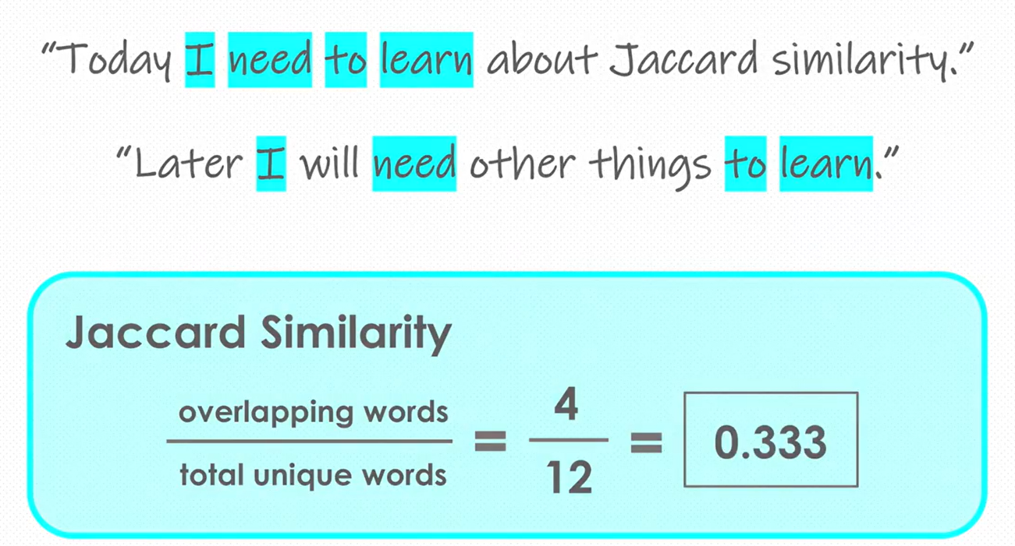
Jaccard Similarity
What it is:
A simple but powerful way to measure how much two sets have in common.
Formula:
Jaccard Similarity = (What they share) / (Everything they have together)

Slide 8
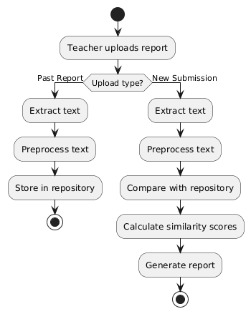
System Flowchart

Slide 9
Project Progress
Completed(50%)
Django project setup and configuration
Report upload system (Past / New submission)
Repository storage using database
Basic text extraction from uploaded files
Jaccard Similarity algorithm implemented
Similarity result display (basic view)
Admin panel integration

Slide 10
Project Progress
Remaining(50%)
Algorithm improvement (text preprocessing, accuracy enhancement)
UI/UX enhancement and professional design
Performance optimization
Plagiarism level classification (Low/Medium/High)
Report generation (optional PDF output)
Complete technical documentation
Testing and validation

